Slide 1
PROJECT ONE · ROUTING · WI-01
Bench setup, frame assembly, motor mounting
STATUS
Complete — 2026-09-20
NEEDS
Everything that has arrived. Not the flight controller.
BATTERY
Stays in the LiPo bag for the entire WI. Not needed, not used.
TIME
~2 h 15 min across five operations
WI-01 · Bench setup, frame assembly, motor mounting
One slide per step · one photo · one check

Slide 2
Deck
1
Tools & parts on the bench
9
Motor screw length — do the math
Op 40
2
Prove the iron: heat, hold, tin
Op 10
10
Loctite: dab, dip, drive
Op 40
3
Three practice joints on scrap
Op 10
11
Seat the motor on the arm
Op 40
4
Inventory the open boxes
Op 20
12
Drive the screws in a cross pattern
Op 40
5
Battery storage-voltage check
Op 20
13
Motor check: free spin, wires untrimmed
Op 40
6
Lay out the frame kit
Op 30
14
Stage the ESC and route the wires
Op 50
7
Bottom plate, arms, standoffs
Op 30
15
End state
8
Frame check: flat and square
Op 30
WI-01 · Bench setup, frame assembly, motor mounting
15 slides

Slide 3
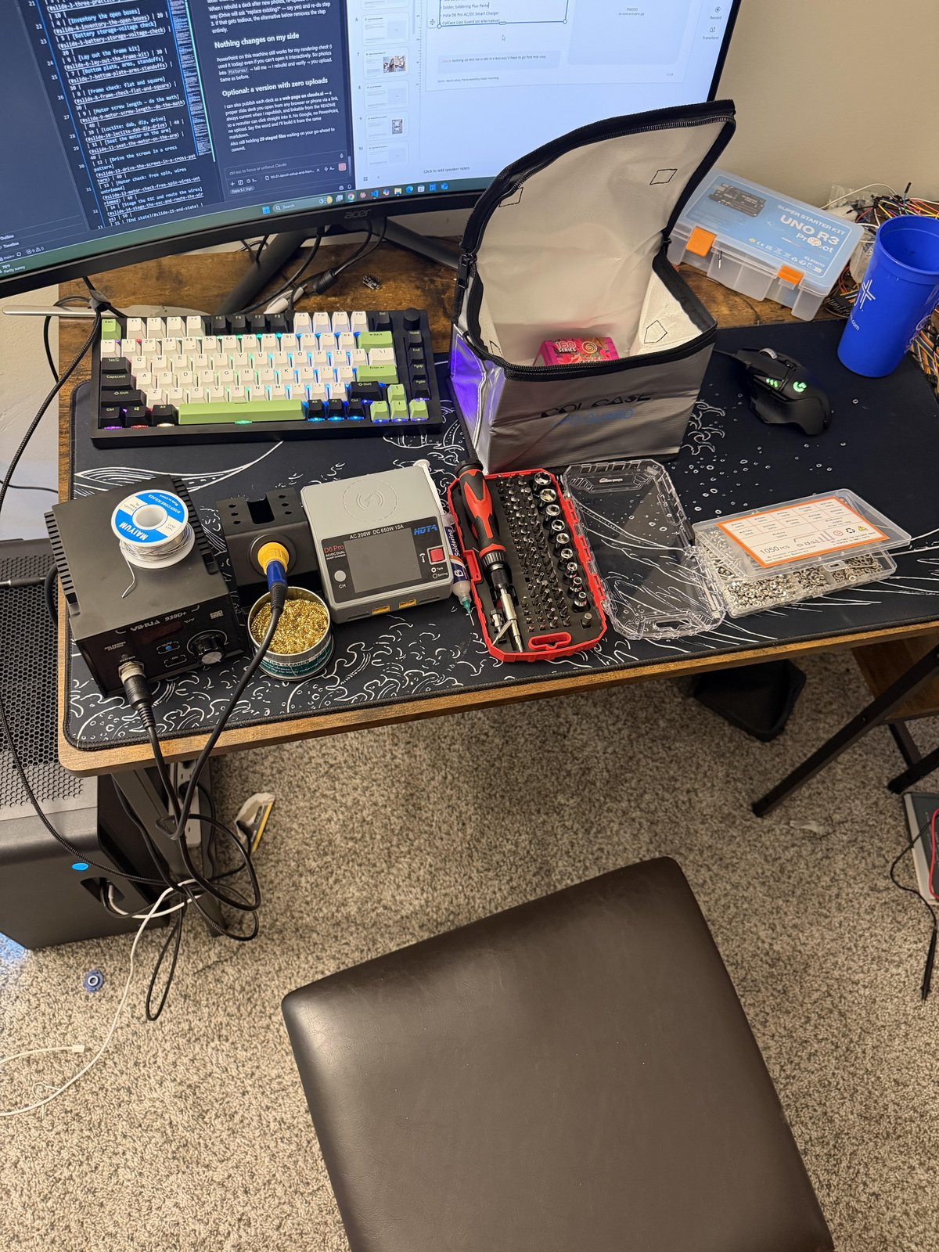
1
Tools & parts on the bench
ON THE BENCH BEFORE STARTING
• Soldering station — YIHUA 939D+ (75 W) with the largest chisel tip
• Hex driver set, multimeter, calipers if you have them
• Safety glasses
• Loctite 243 (blue)
• Frame kit — TBS Source One V6, 5"
• Motors ×4 — EMAX ECO II 2207 1900KV
• M3 screw assortment
• ESC — Skystars KO60II 60A AM32
• Solder, flux, wick, scrap wire, heat shrink
CHECK nothing on this list is still in a box you'd have to go find mid-step.
WI-01 · Bench setup, frame assembly, motor mounting
1 / 15

Slide 4
2
Prove the iron: heat, hold, tin
OP 10 · 5 MIN
The AiXun sat in its box, turned out to be defective, and cost a week. The first thing the new iron does is prove it works.
PHOTO
02-iron-at-temperature.jpg
DO
1. Power on the YIHUA. Set 350 °C / 662 °F.
2. Fit the largest chisel tip.
3. Tin it — touch solder to the hot tip.
CHECK display reaches and holds temperature. Solder flows and coats the tip instantly; if it balls up, the tip isn't hot or isn't clean.
WI-01 · Bench setup, frame assembly, motor mounting
2 / 15

Slide 5
3
Three practice joints on scrap
OP 10 · 10 MIN
DO — THREE TIMES, BEFORE ANY REAL JOINT:
PHOTO
03-practice-joint.jpg
1. Tin two scrap wire ends.
2. Join them.
3. Slide heat shrink over the joint and shrink it — iron barrel held near, rotate the wire. No heat gun needed.
CHECK joint is shiny and solid, shrink is tight over it. Three in a row that pass, or keep practicing.
WI-01 · Bench setup, frame assembly, motor mounting
3 / 15

Slide 6
4
Inventory the open boxes
OP 20 · 5 MIN
DO
PHOTO
04-inventory.jpg
1. Amazon bundle — confirm the M3 screw assortment and the safety glasses are present.
2. ESC box — note whether a capacitor and/or XT60 lead is included. The better part goes on the aircraft; the other becomes the spare.
CHECK both tracker flags cleared; ESC box contents written down.
WI-01 · Bench setup, frame assembly, motor mounting
4 / 15

Slide 7
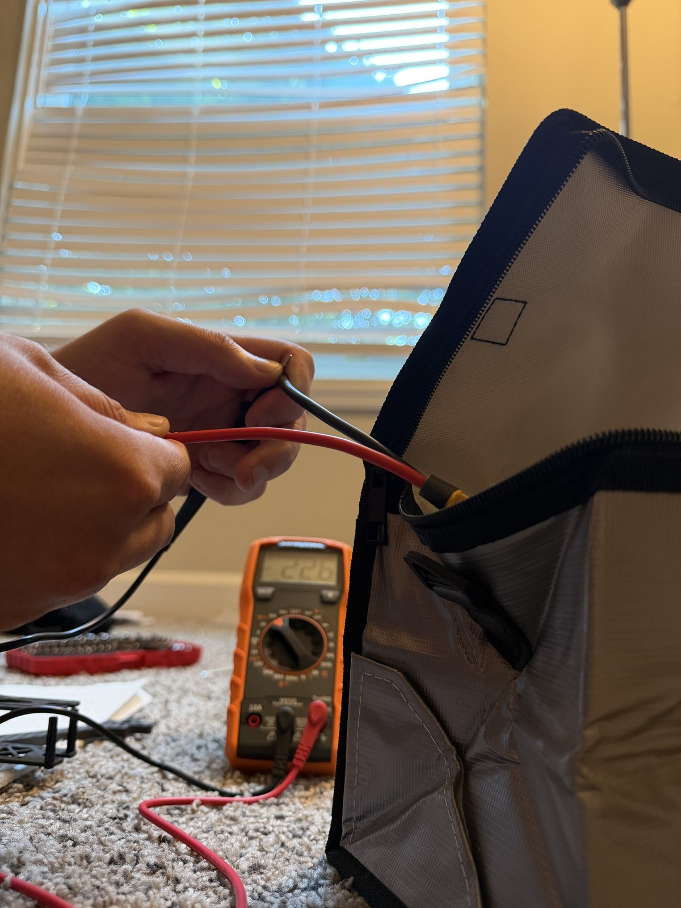
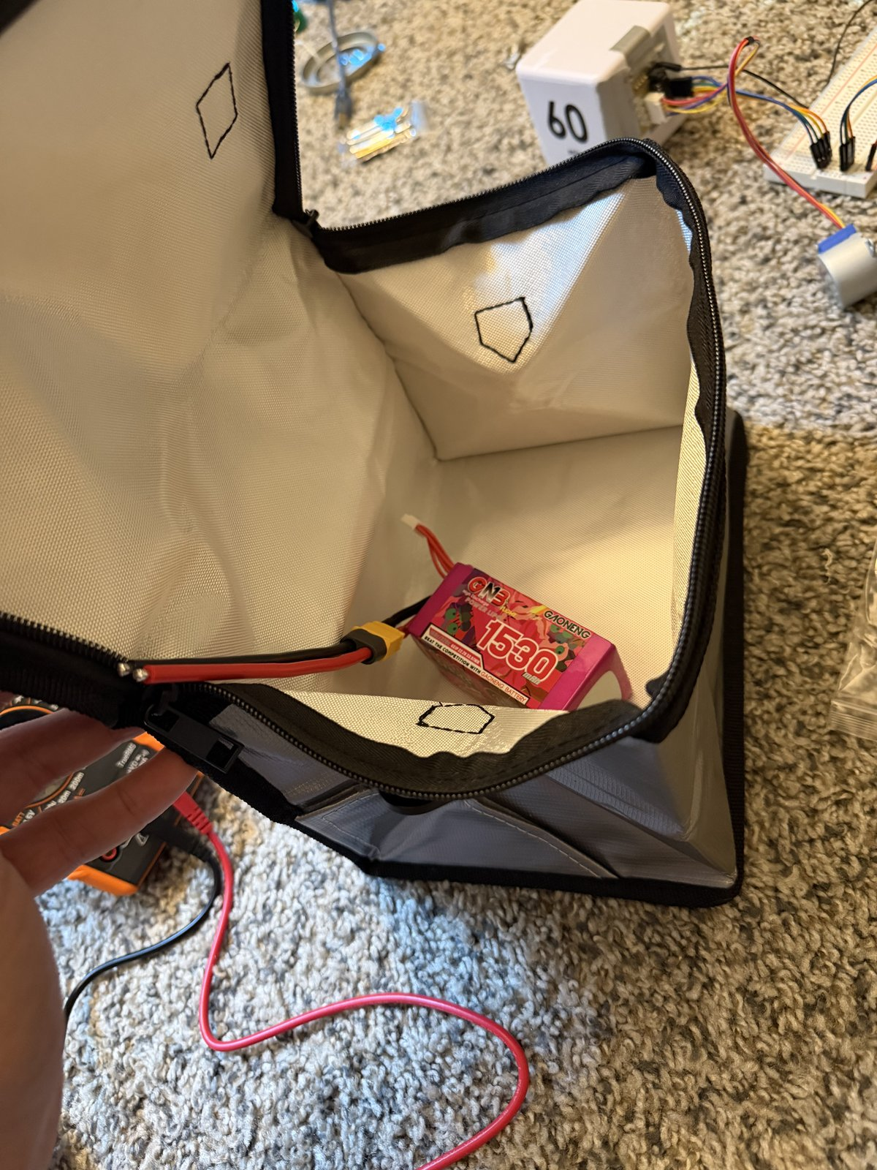
5
Battery storage-voltage check
OP 20 · 5 MIN
DO
1. Multimeter on DC volts.
2. Measure pack voltage at the XT60 — red probe to the + pin, black to −.
3. Straight back into the LiPo bag.
CHECK ~22.2–22.8 V for a 6S pack at storage charge (3.7–3.8 V per cell). Anything far outside that range is a question for the charger, not the bench.
WI-01 · Bench setup, frame assembly, motor mounting
5 / 15

Slide 8
6
Lay out the frame kit
OP 30 · 10 MIN
DO
PHOTO
06-frame-kit-layout.jpg
1. Lay out every Source One V6 plate, arm, standoff, and bag of hardware against the kit sheet.
2. Sort the hardware by length. The kit's M3×10 / 12 / 14 screws are standoff hardware — they are not motor screws.
CHECK everything on the kit sheet is present and sorted before a single screw is driven.
WI-01 · Bench setup, frame assembly, motor mounting
6 / 15

Slide 9
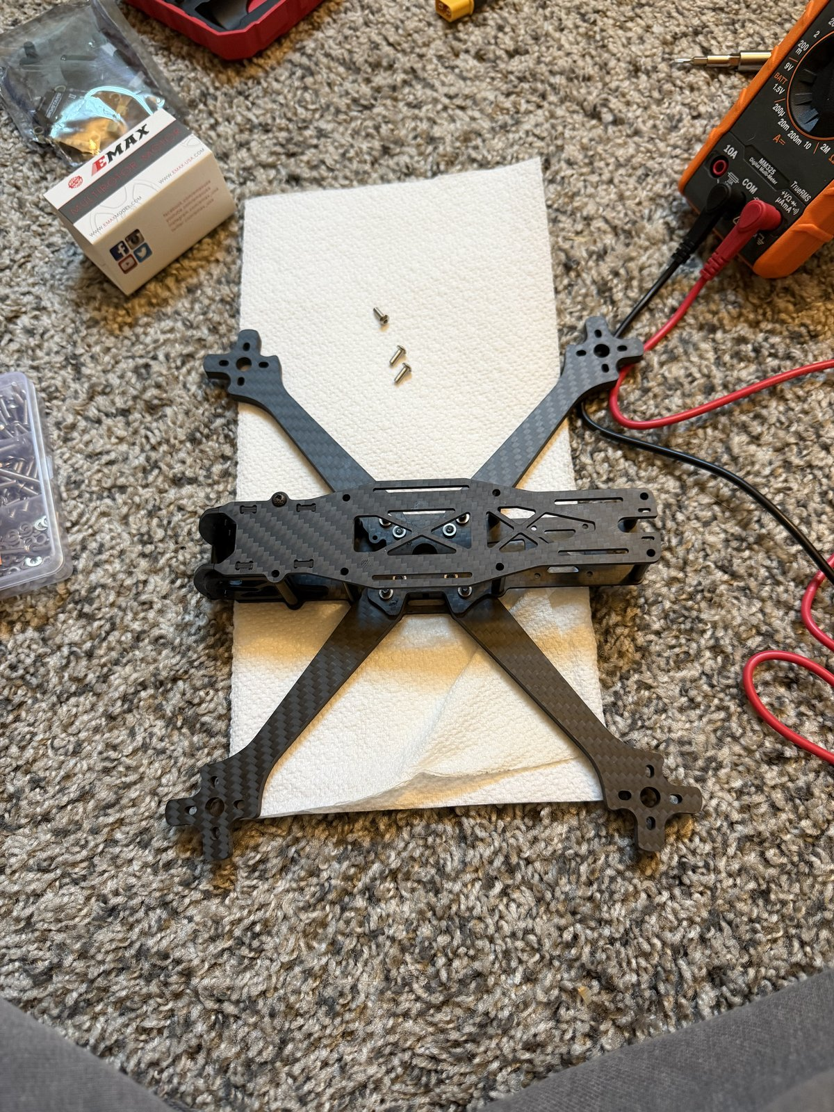
7
Bottom plate, arms, standoffs
OP 30 · 30 MIN
DO
1. Bottom plate first, then the four arms, then the standoffs.
2. One drop of blue Loctite on each frame bolt.
3. Snug, not gorilla-tight. Carbon fibre crushes under an over-torqued bolt and there is no undoing it.
CHECK every frame bolt has Loctite and is snug; no bolt bottomed out.
WI-01 · Bench setup, frame assembly, motor mounting
7 / 15

Slide 10
8
Frame check: flat and square
OP 30 · 5 MIN
DO
PHOTO
08-frame-flat-check.jpg
1. Set the assembled frame on a flat surface and press each arm tip.
2. Sight down the stack holes.
CHECK no rock on any arm. Stack holes line up on the 30 × 30 mm pattern — the FC and ESC both mount to it.
WI-01 · Bench setup, frame assembly, motor mounting
8 / 15

Slide 11
9
Motor screw length — do the math
OP 40 · 10 MIN
CAUTION Wrong screw length is the #1 motor killer. A screw that reaches the windings shorts the motor the first time it spins. Do the math before driving any screw.
PHOTO
09-screw-length-measure.jpg
DO
1. Measure arm thickness — calipers, or the edge of the multimeter case (~6 mm).
2. Measure the motor's blind-hole depth.
3. Target thread into the motor = arm + ~5 mm. Pick screws from the assortment to match.
CHECK test-fit a screw through the arm into a motor by hand — the tip sits at least 1 mm short of the hole bottom.
WI-01 · Bench setup, frame assembly, motor mounting
9 / 15

Slide 12
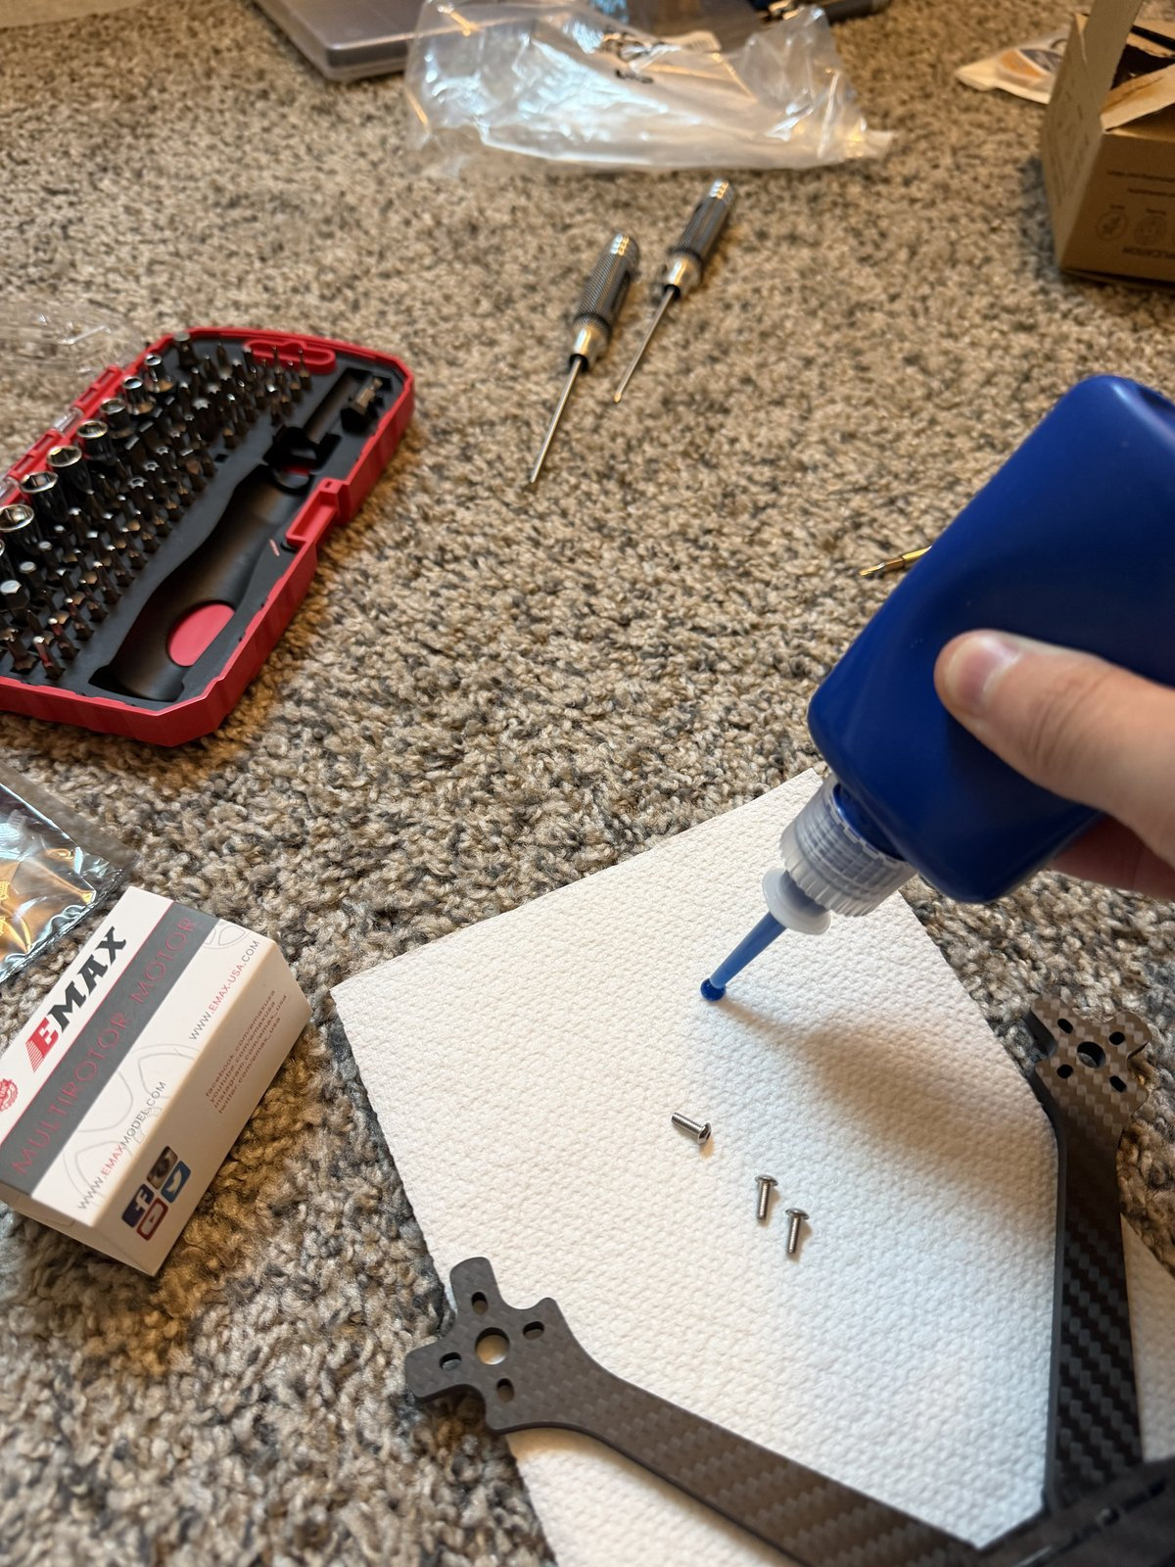
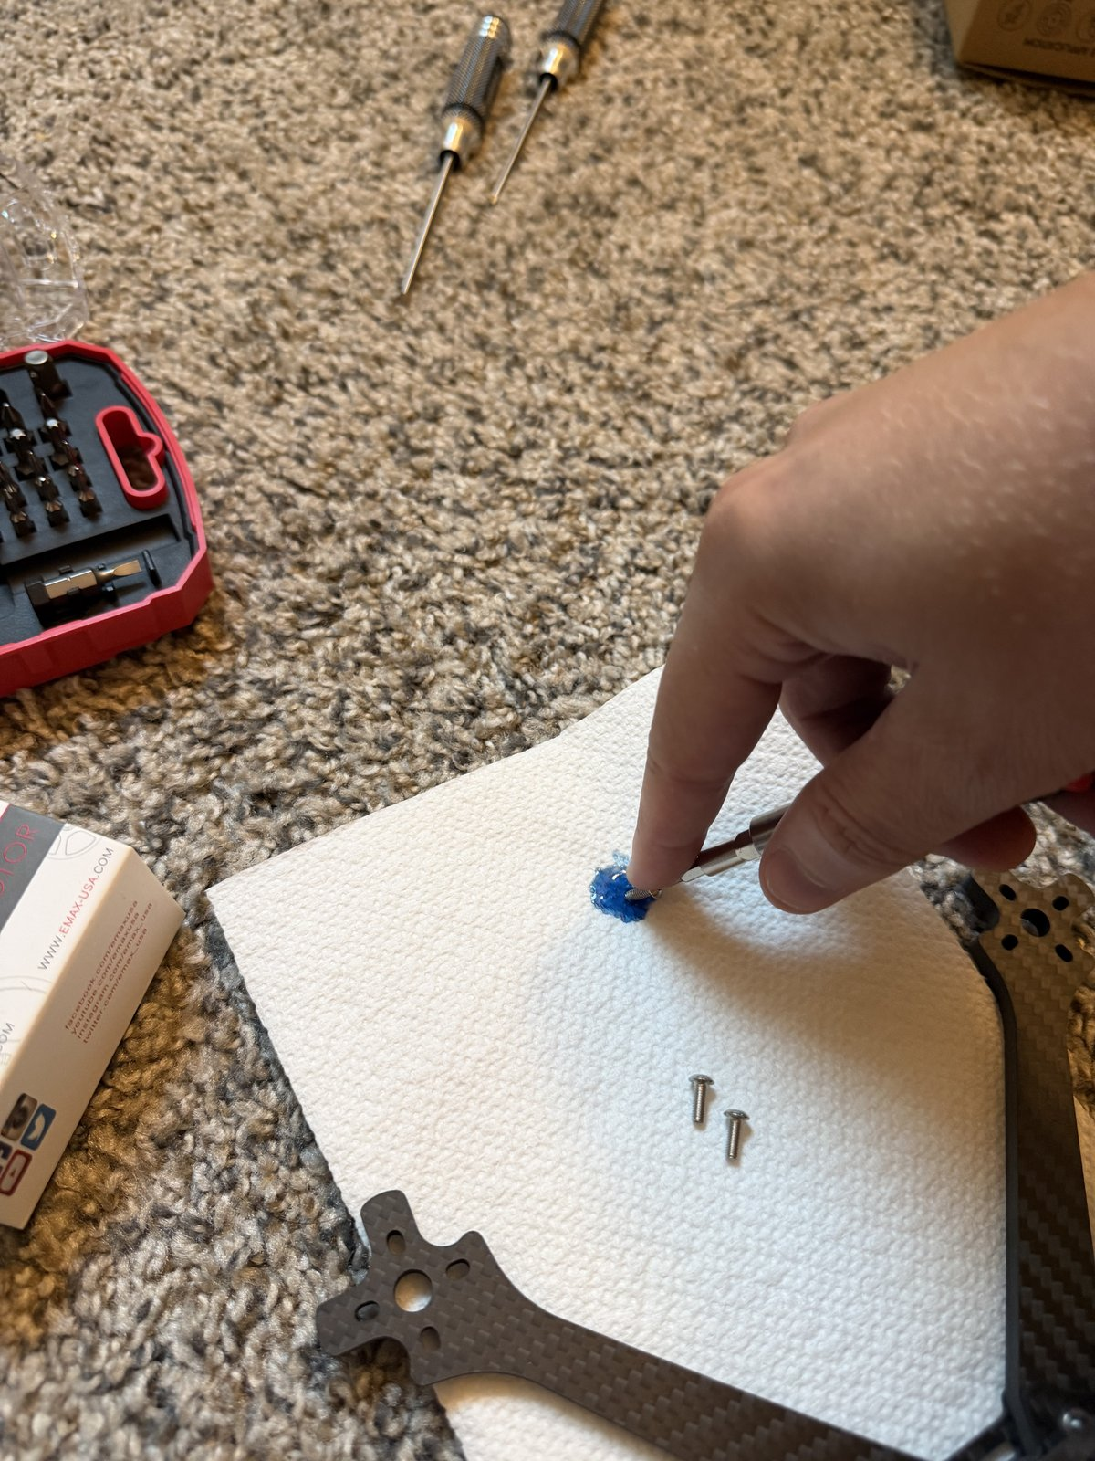
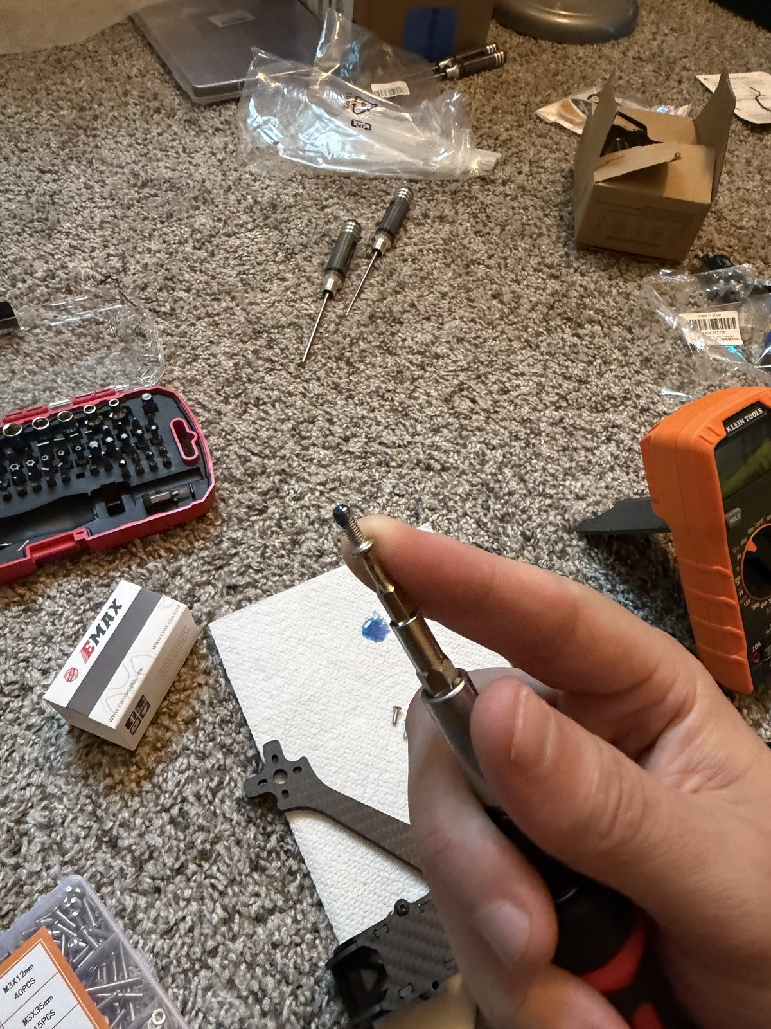
10
Loctite: dab, dip, drive
OP 40 · 5 MIN
The bottle nozzle puts far too much on a screw this small. Dab, then dip.
DO
1. Squeeze one drop of blue Loctite 243 onto a paper towel.
2. Touch each screw's threads into the drop — a thin film, not a coating.
3. Drive it within a minute or two, before it starts to set.
CHECK blue on the threads only, none on the screw head or the carbon.
WI-01 · Bench setup, frame assembly, motor mounting
10 / 15

Slide 13
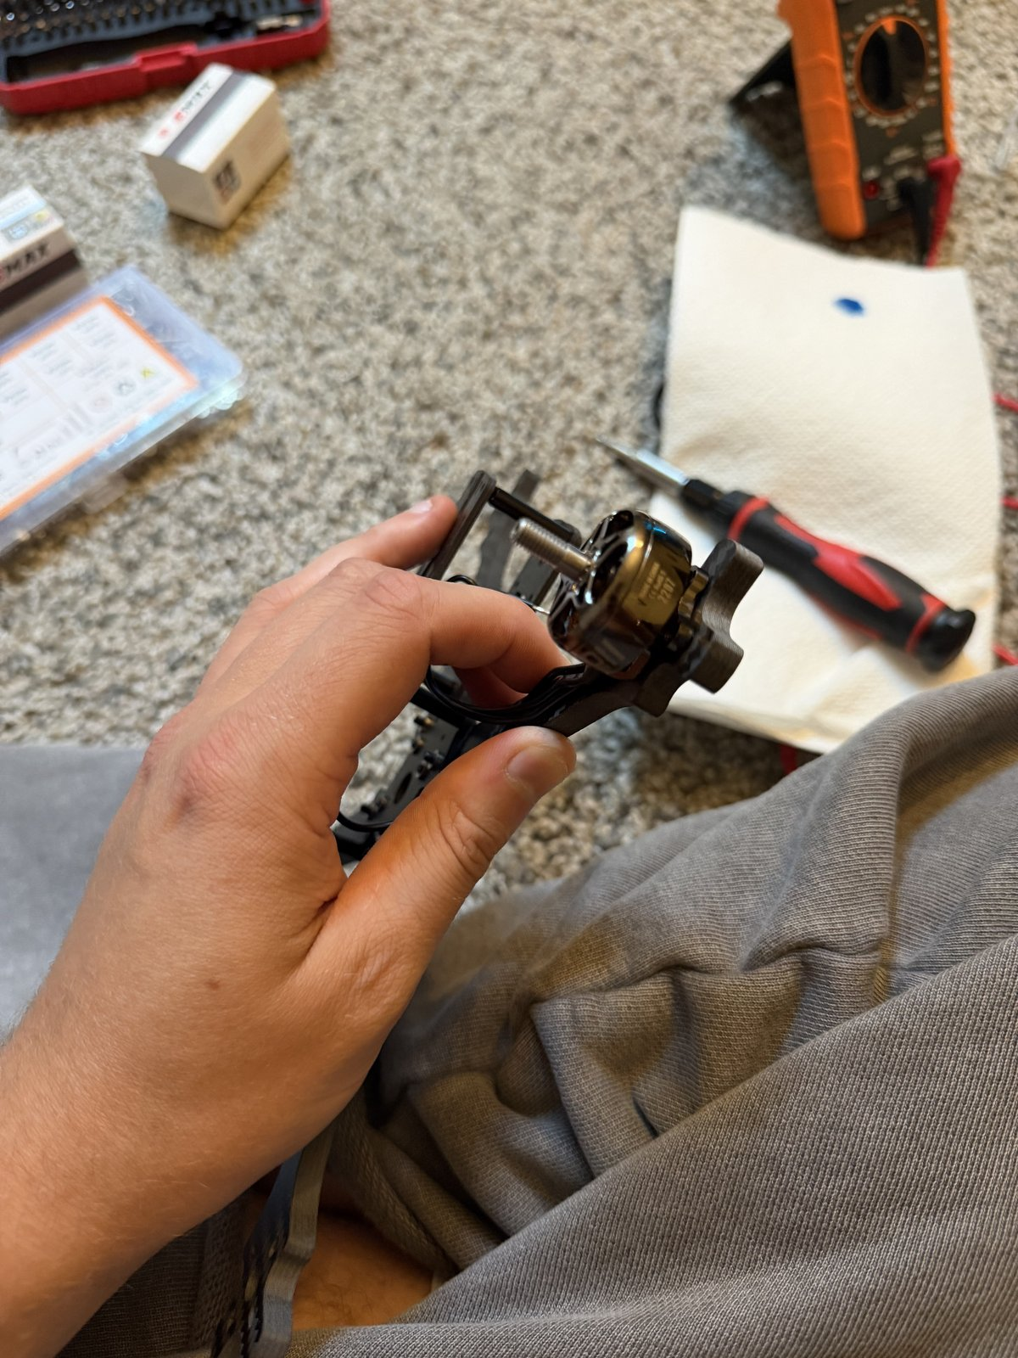
11
Seat the motor on the arm
OP 40 · 10 MIN
SAFETY GLASSES ON.
DO
1. Set the motor on the arm end, bolt holes aligned with the arm's 16 × 16 mm pattern.
2. Wires pointing inboard, toward the centre of the frame.
3. Hold it flat while the first screw goes in.
CHECK motor base sits flush on the arm, all four holes visible through the arm, wires headed toward the stack.
WI-01 · Bench setup, frame assembly, motor mounting
11 / 15

Slide 14
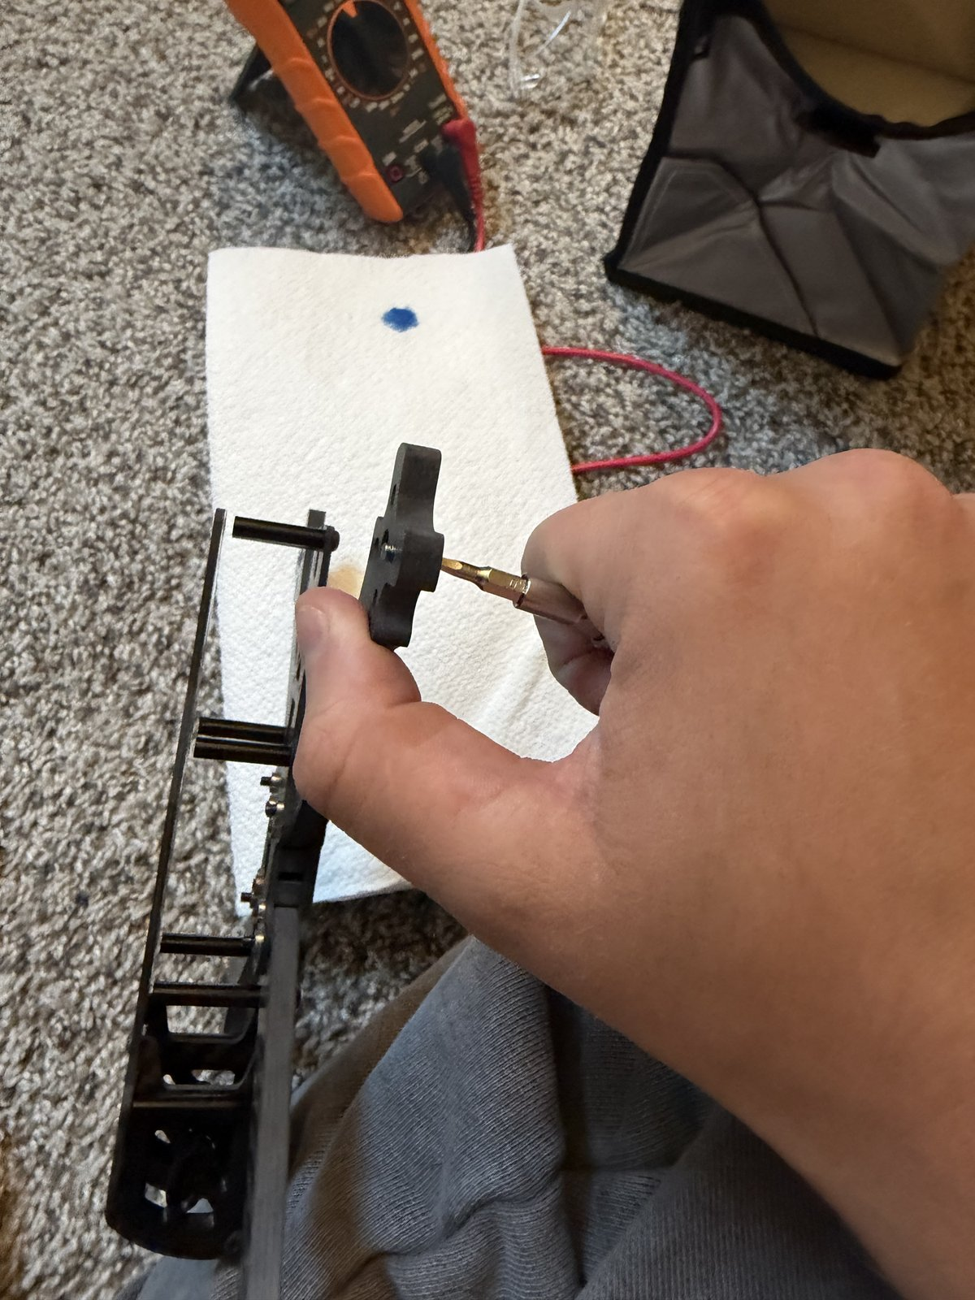
12
Drive the screws in a cross pattern
OP 40 · 20 MIN
DO
1. Screws go up through the arm, into the motor — from underneath.
2. Drive them in a cross pattern — one corner, then the opposite corner, then the other pair — so the motor seats flat, not tilted.
3. Snug only. Same rule as the frame bolts.
4. Repeat for all four motors.
CHECK all 16 screws in, all Loctited, no gap between motor base and arm on any motor.
WI-01 · Bench setup, frame assembly, motor mounting
12 / 15

Slide 15
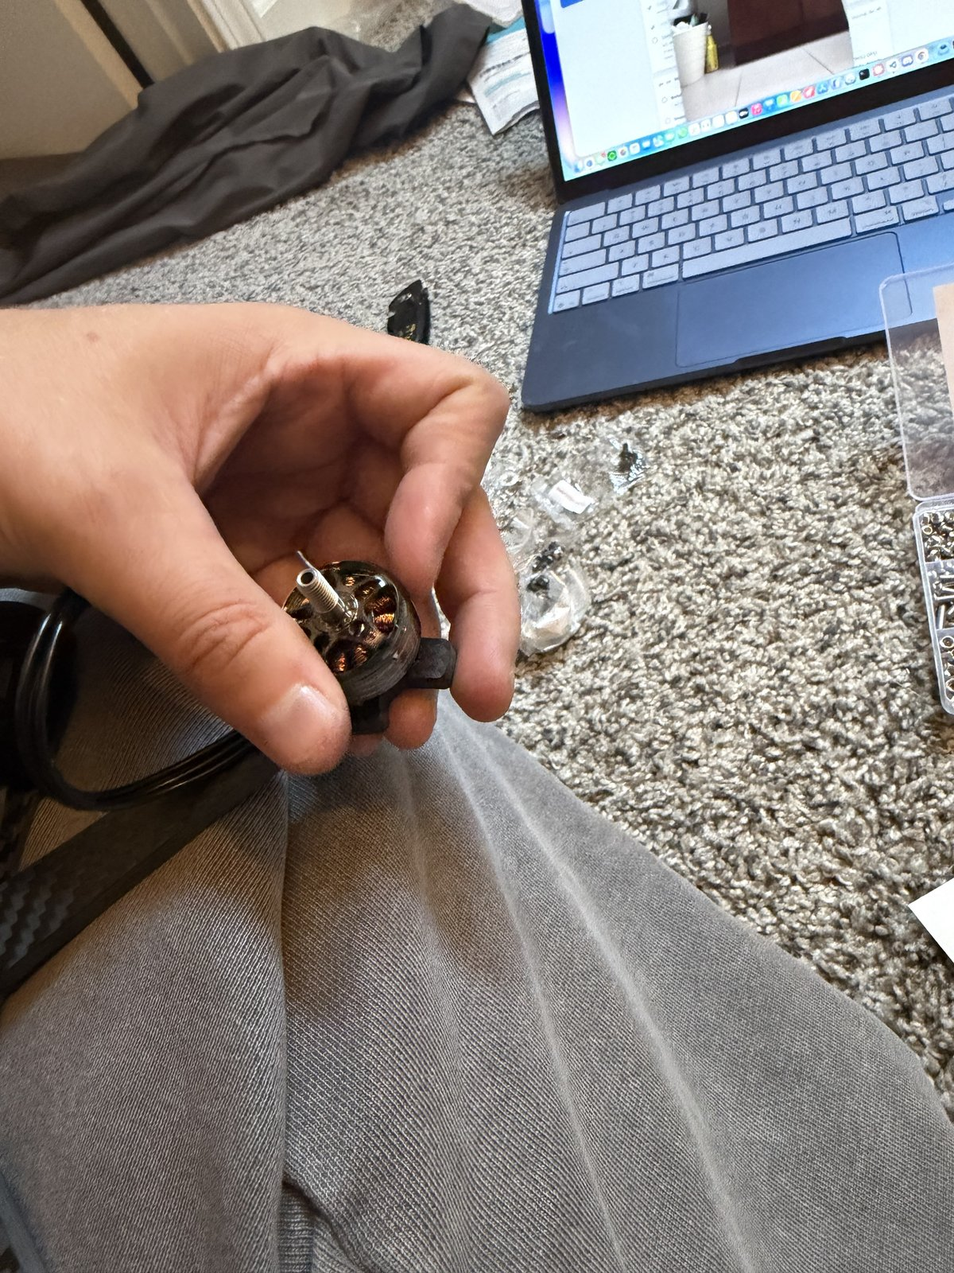
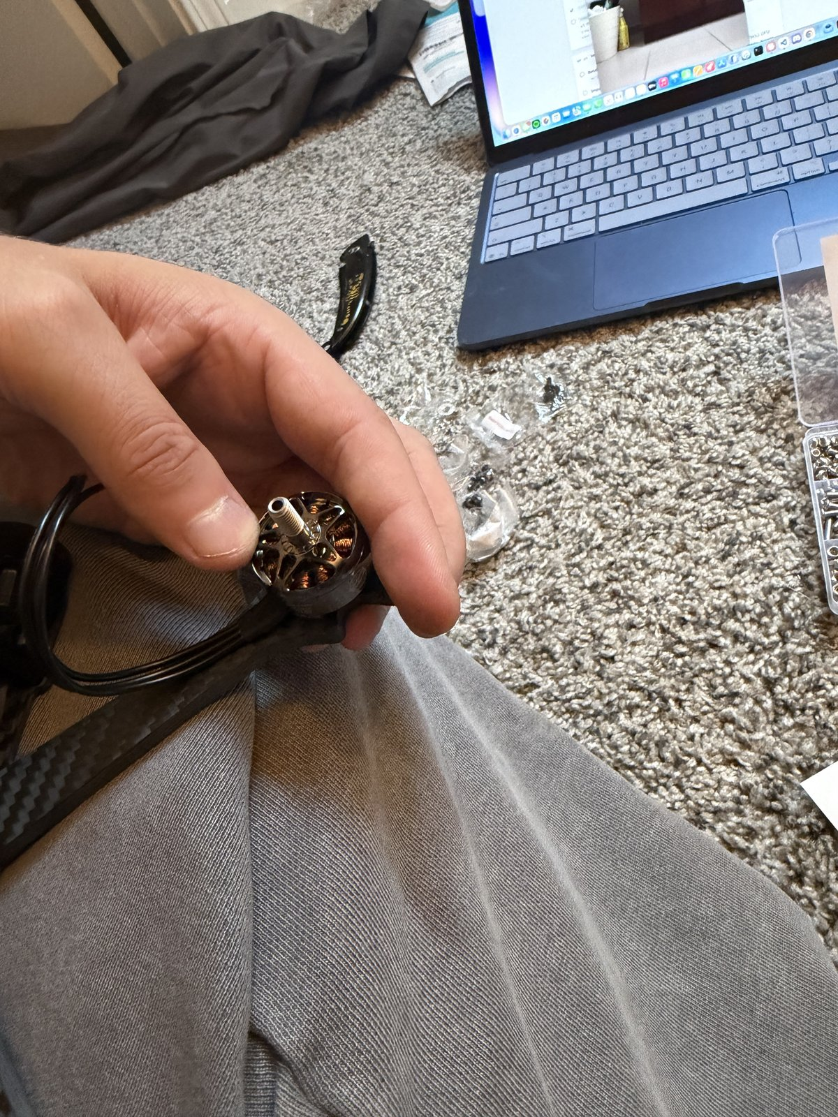
13
Motor check: free spin, wires untrimmed
OP 40 · 5 MIN
DO
1. Spin each motor bell by hand — both directions.
2. Leave every motor wire at full length.
CHECK each motor spins freely both ways — no scraping, no wobble, no tick. A tick means a screw is touching the windings: back it out now. Do not trim motor wires yet; final length depends on where the ESC sits.
WI-01 · Bench setup, frame assembly, motor mounting
13 / 15

Slide 16
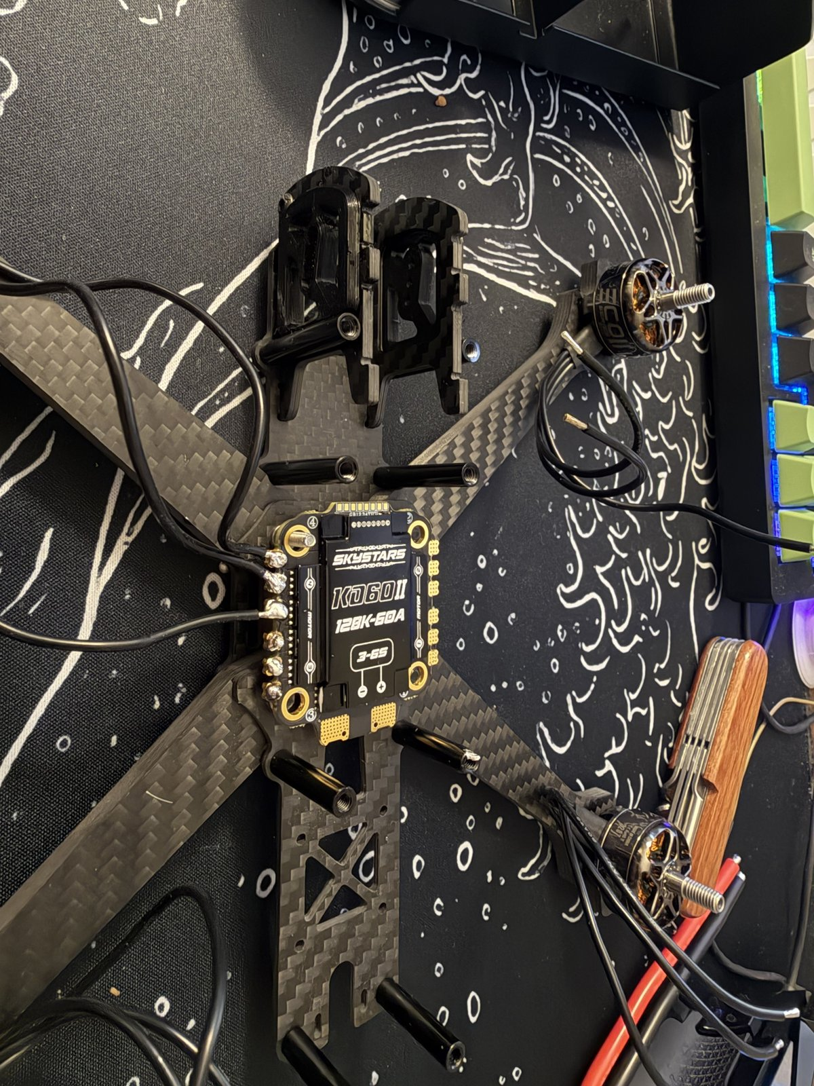
14
Stage the ESC and route the wires
OP 50 · 15 MIN
DO
1. Dry-fit the ESC on the stack standoffs, arrow / battery pads facing the rear of the aircraft.
2. Route each motor's three wires to its ESC corner.
3. Mark the trim length on each wire with a scrap of tape.
CHECK every wire reaches its pads with a little slack, and no wire crosses a prop line.
WI-01 · Bench setup, frame assembly, motor mounting
14 / 15

Slide 17
15
End state
WI-01 IS DONE WHEN ALL OF THESE ARE TRUE:
PHOTO
15-end-state.jpg
• Iron proven at temperature; three practice joints passed
• Inventory flags cleared; ESC box contents recorded
• Battery measured at storage voltage and back in the bag
• Frame assembled, Loctited, flat, stack holes on 30 × 30
• Four motors mounted with verified screw length; all spin free
• ESC staged; every motor wire routed and tape-marked, none trimmed
NEXT WI-02 — ESC soldering
WI-01 · Bench setup, frame assembly, motor mounting
15 / 15

